Slide 1
Azure Databricks - Overview
Farah Omer
Jake Wang

Slide 2
The modern data estate
LOB
CRM
Graph
Image
Social
IoT
Hybrid
Operational databases
Operational databases
Data warehouses
Data warehouses
Data Lakes
Data Lakes
Reason over any data, anywhere
Flexibility of choice
Security and performance
Notes:
All kinds of data being generated
Stored on-premises and in the cloud – but vast majority in hybrid
Reason over all this data without requiring to move data
They want a choice of platform and languages, privacy and security
<Transition> Microsoft’s offerng

Slide 3
Big Data & Advanced Analytics in Azure

Slide 4
Big Data & Advanced Analytics at a glance
Ingest
Store
Prep & Train
Model & Serve
Intelligence
Business apps
Data Factory
(Data movement, pipelines & orchestration)
Cosmos DB
Predictive apps
Blobs
Data Lake
Databricks
HDInsight
Data Lake Analytics
SQL
Custom apps
Kafka
10 01
SQL Database
SQL Data Warehouse
Operational reports
Event Hub
IoT Hub
Machine Learning
Sensors and devices
Analysis Services
Analytical dashboards
Notes:
Azure build-out of DMSA. Supports hybrid\on-premises too through ADF \ Blob \ Stretch.

Slide 5






Machine Learning
Domain specific pretrained models
To simplify solution development
…
Vision
Speech
Language
Search
Familiar Data Science tools
To simplify model development
Visual Studio Code
Azure Notebooks
Jupyter
Command line
Popular frameworks
To build advanced deep learning solutions
PyTorch
TensorFlow
Scikit-Learn
ONNX
Productive services
To empower data science and development teams
Azure Databricks
Azure Machine Learning
Machine Learning VMs
Powerful infrastructure
To accelerate deep learning
CPU
GPU
FPGA
From the Intelligent Cloud to the Intelligent Edge

Slide 6
Azure Databricks Powered by Apache Spark

Slide 7

Why Spark?
Open-source data processing engine built around speed, ease of use, and sophisticated analytics
In memory engine that is up to 100 times faster than Hadoop
Largest open-source data project with 1000+ contributors
Highly extensible with support for Scala, Java and Python alongside Spark SQL, GraphX, Streaming and Machine Learning Library (Mllib)
Notes:
When it comes to ease of use, Spark again happens to be a lot better than Hadoop. Spark has APIs for several languages such as Scala, Java and Python, besides having the likes of Spark SQL. It is relatively simple to write user-defined functions. It also happens to boast an interactive mode for running commands. Hadoop, on the other hand, is written in Java and has earned the reputation of being pretty difficult to program, although it does have tools that assist in the process. (To learn more about Spark, see How Apache Spark Helps Rapid Application Development.)
In-Memory Technology
One of the unique aspects of Apache Spark is its unique "in-memory" technology that allows it to be an extremely good data processing system. In this technology, Spark loads all of the data to the internal memory of the system and then unloads it on the disk later. This way, a user can save a part of the processed data on the internal memory and leave the remaining on the disk.
Spark also has an innate ability to load necessary information to its core with the help of its machine learningalgorithms. This allows it to be extremely fast.
Spark’s Core
Spark’s core manages several important functions like setting tasks and interactions as well as producing input/output operations. It can be said to be an RDD, or resilient distributed dataset. Basically, this happens to be a mix of data that is spread across several machines connected via a network. The transformation of this data is created by a four-step method, comprised of mapping the data, sorting it, reducing it and then finally, joining the data.
Following this step is the release of the RDD, which is done with support from an API. This API is a union of three languages: Scala, Java and Python.
Spark’s SQL
Apache Spark’s SQL has a relatively new data management solution called SchemaRDD. This allows the arrangement of data into many levels and can also query data via a specific language.
Graphx Service
Apache Spark comes with the ability to process graphs or even information that is graphical in nature, thus enabling the easy analysis with a lot of precision.
Streaming
This is a prime part of Spark that allows it to stream large chunks of data with help from the core. It does so by breaking the large data into smaller packets and then transforming them, thereby accelerating the creation of the RDD.
MLib – Machine Learning Library
Apache Spark has the MLib, which is a framework meant for structured machine learning. It is also predominantly faster in implementation than Hadoop. MLib is also capable of solving several problems, such as statistical reading, data sampling and premise testing, to name a few.

Slide 8
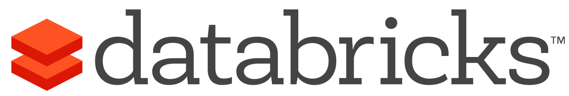


What is Azure Databricks?
A fast, easy and collaborative Apache® Spark™ based analytics platform optimized for Azure
Best of Databricks
Best of Microsoft
Designed in collaboration with the founders of Apache Spark
One-click set up; streamlined workflows
Interactive workspace that enables collaboration between data scientists, data engineers, and business analysts.
Native integration with Azure services (Power BI, SQL DW, Cosmos DB, Blob Storage)
Enterprise-grade Azure security (Active Directory integration, compliance, enterprise-grade SLAs)
Notes:
Azure Databricks features –
Enhance your teams’ productivity
Get started quickly by launching your new Spark environment with one click.
Share your insights in powerful ways through rich integration with PowerBI.
Improve collaboration amongst your analytics team through a unified workspace.
Innovate faster with native integration with rest of Azure platform.
Build on the most compliant and trusted cloud
Simplify security and identity control with built-in integration with Active Directory.
Regulate access with fine-grained user permissions to Azure Databricks’ notebooks, clusters, jobs and data.
Build with confidence on the trusted cloud backed by unmatched support, compliance and SLAs.
Scale without limits
Operate at massive scale without limits globally.
Accelerate data processing with the fastest Spark engine.

Slide 9
Differentiated experience on Azure
ENHANCE PRODUCTIVITY
BUILD ON THE MOST COMPLIANT CLOUD
SCALE WITHOUT LIMITS
Get started quickly by launching your new Spark environment with one click.
Share your insights in powerful ways through rich integration with Power BI.
Improve collaboration amongst your analytics team through a unified workspace.
Innovate faster with native integration with rest of Azure platform
Simplify security and identity control with built-in integration with Active Directory. Regulate access with fine-grained user permissions to Azure Databricks’ notebooks, clusters, jobs and data.
Build with confidence on the trusted cloud backed by unmatched support, compliance and SLAs.
Operate at massive scale without limits globally.
Accelerate data processing with the fastest Spark engine.
Notes:
Databricks, founded by the team that created Apache Spark – unified analytics platform that accelerates innovation by unifying data science, engineering & business.
75% of the code committed to Apache Spark comes from Databricks
Unified Runtime
Create clusters in seconds, dynamically scale them up and down.
They’ve made enhancements to Spark engine to make it 10x faster than open source Spark
Serverless- Auto-configured multi-user cluster, Reliable sharing with fault isolation
Unified Collaboration
Overall – a simple & collaborative environment that enables your entire team to use Spark & interact with your data simultaneously
DE – Improve ETL performance, zero management clusters. Execute production code from within notebooks
DS - For data scientists, easy data exploration in notebooks
Business SME – interactive dashboards empower teams to create dynamic reports
Enterprise Security
Encryption
Fine grained Role-based access control (files, clusters, code, application, dashboard)
Compliance
Rest APIs
DE – DBIO, SPARK, API’s , JOBS
DS – Spark and Serverless, Interactive Data Science
Data Products - Everything
Creators of Spark
Training People
Number of Customers
Ingest
Workflow
Schedule / Run / Monitor
Execute
Troubleshoot
Debug
Production Jobs
---------
Ingest, ETL, Scheduling, Monitoring

Slide 10

Azure Databricks
Azure Databricks
Collaborative Workspace
IoT / streaming data
Machine learning models
DATA ENGINEER
DATA SCIENTIST
BUSINESS ANALYST
Deploy Production Jobs & Workflows
Cloud storage
BI tools
MULTI-STAGE PIPELINES
JOB SCHEDULER
NOTIFICATION & LOGS
Data warehouses
Optimized Databricks Runtime Engine
Data exports
Hadoop storage
DATABRICKS I/O
APACHE SPARK
SERVERLESS
Rest APIs
Data warehouses
Enhance Productivity
Build on secure & trusted cloud
Scale without limits
Notes:
Databricks, founded by the team that created Apache Spark – unified analytics platform that accelerates innovation by unifying data science, engineering & business.
75% of the code committed to Apache Spark comes from Databricks
Unified Runtime
Create clusters in seconds, dynamically scale them up and down.
They’ve made enhancements to Spark engine to make it 10x faster than open source Spark
Serverless- Auto-configured multi-user cluster, Reliable sharing with fault isolation
Unified Collaboration
Overall – a simple & collaborative environment that enables your entire team to use Spark & interact with your data simultaneously
DE – Improve ETL performance, zero management clusters. Execute production code from within notebooks
DS - For data scientists, easy data exploration in notebooks
Business SME – interactive dashboards empower teams to create dynamic reports
Enterprise Security
Encryption
Fine grained Role-based access control (files, clusters, code, application, dashboard)
Compliance
Rest APIs
DE – DBIO, SPARK, API’s , JOBS
DS – Spark and Serverless, Interactive Data Science
Data Products - Everything
Creators of Spark
Training People
Number of Customers
Ingest
Workflow
Schedule / Run / Monitor
Execute
Troubleshoot
Debug
Production Jobs
---------
Ingest, ETL, Scheduling, Monitoring

Slide 11

Available Regions
Central US
East US
East US 2
North Central US
North Europe
South Central US
West US
West US 2
Australia Central
Australia Central 2
Australia East
Australia Southeast
Canada Central
Canada East
Central India
East Asia
Japan East
Japan West
South India
Southeast Asia
UK South
UK West
West Europe
West India

Slide 12
Collaborative Workspace
GET STARTED IN SECONDS
Single click to launch your new Spark environment
INTERACTIVE EXPLORATION
Explore data using interactive notebooks with support for multiple programming languages including R, Python, Scala, and SQL
COLLABORATION
Work on the same notebook in real-time while tracking changes with detailed revision history, GitHub, or Bitbucket
VISUALIZATIONS
Visualize insights through a wide assortment of point-and-click visualizations. Or use powerful scriptable options like matplotlib, ggplot, and D3
DASHBOARDS
Rich integration with PowerBI to discover and share your insights in powerful new ways
Azure Databricks
Collaborative Workspace
DATA ENGINEER
DATA SCIENTIST
BUSINESS ANALYST
Deploy Production Jobs & Workflows
MULTI-STAGE PIPELINES
JOB SCHEDULER
NOTIFICATION & LOGS
Optimized Databricks Runtime Engine
DATABRICKS I/O
APACHE SPARK
SERVERLESS
Rest APIs
Notes:
Databricks, founded by the team that created Apache Spark – unified analytics platform that accelerates innovation by unifying data science, engineering & business.
75% of the code committed to Apache Spark comes from Databricks
Unified Runtime
Create clusters in seconds, dynamically scale them up and down.
They’ve made enhancements to Spark engine to make it 10x faster than open source Spark
Serverless- Auto-configured multi-user cluster, Reliable sharing with fault isolation
Unified Collaboration
Overall – a simple & collaborative environment that enables your entire team to use Spark & interact with your data simultaneously
DE – Improve ETL performance, zero management clusters. Execute production code from within notebooks
DS - For data scientists, easy data exploration in notebooks
Business SME – interactive dashboards empower teams to create dynamic reports
Enterprise Security
Encryption
Fine grained Role-based access control (files, clusters, code, application, dashboard)
Compliance
Rest APIs
DE – DBIO, SPARK, API’s , JOBS
DS – Spark and Serverless, Interactive Data Science
Data Products - Everything
Creators of Spark
Training People
Number of Customers
Ingest
Workflow
Schedule / Run / Monitor
Execute
Troubleshoot
Debug
Production Jobs
---------
Ingest, ETL, Scheduling, Monitoring

Slide 13
Deploy Production Jobs & Workflows
JOBS SCHEDULER
Execute jobs for production pipelines on a specific schedule
NOTEBOOK WORKFLOWS
Create multi-stage pipelines with the control structures of the source programming language
RUN NOTEBOOKS AS JOBS
Turn notebooks or JARs into resilient Spark jobs with a click or an API call
NOTIFICATIONS AND LOGS
Set up alerts and quickly access audit logs for easy monitoring and troubleshooting
INTEGRATE NATIVELY WITH AZURE SERVICES
Deep integration with Azure SQL Data Warehouse, Cosmos DB, Azure Data Lake Store, Azure Blob Storage, and Azure Event Hub
Azure Databricks
Collaborative Workspace
DATA ENGINEER
DATA SCIENTIST
BUSINESS ANALYST
Deploy Production Jobs & Workflows
MULTI-STAGE PIPELINES
JOB SCHEDULER
NOTIFICATION & LOGS
Optimized Databricks Runtime Engine
DATABRICKS I/O
APACHE SPARK
SERVERLESS
Rest APIs
Notes:
Databricks, founded by the team that created Apache Spark – unified analytics platform that accelerates innovation by unifying data science, engineering & business.
75% of the code committed to Apache Spark comes from Databricks
Unified Runtime
Create clusters in seconds, dynamically scale them up and down.
They’ve made enhancements to Spark engine to make it 10x faster than open source Spark
Serverless- Auto-configured multi-user cluster, Reliable sharing with fault isolation
Unified Collaboration
Overall – a simple & collaborative environment that enables your entire team to use Spark & interact with your data simultaneously
DE – Improve ETL performance, zero management clusters. Execute production code from within notebooks
DS - For data scientists, easy data exploration in notebooks
Business SME – interactive dashboards empower teams to create dynamic reports
Enterprise Security
Encryption
Fine grained Role-based access control (files, clusters, code, application, dashboard)
Compliance
Rest APIs
DE – DBIO, SPARK, API’s , JOBS
DS – Spark and Serverless, Interactive Data Science
Data Products - Everything
Creators of Spark
Training People
Number of Customers
Ingest
Workflow
Schedule / Run / Monitor
Execute
Troubleshoot
Debug
Production Jobs
---------
Ingest, ETL, Scheduling, Monitoring

Slide 14
Optimized Databricks Runtime Engine
OPTIMIZED I/O PERFORMANCE
The Databricks I/O module (DBIO) takes processing speeds to the next level — significantly improving the performance of Spark in the cloud
FULLY-MANAGED PLATFORM ON AZURE
Reap the benefits of a fully managed service and remove the complexity of big data and machine learning
SERVERLESS INFRASTRUCTURE
Databricks’ serverless and highly elastic cloud service is designed to remove operational complexity while ensuring reliability and cost efficiency at scale
OPERATE AT MASSIVE SCALE
Without limits globally
Azure Databricks
Collaborative Workspace
DATA ENGINEER
DATA SCIENTIST
BUSINESS ANALYST
Deploy Production Jobs & Workflows
MULTI-STAGE PIPELINES
JOB SCHEDULER
NOTIFICATION & LOGS
Optimized Databricks Runtime Engine
DATABRICKS I/O
APACHE SPARK
SERVERLESS
Rest APIs
Notes:
Databricks, founded by the team that created Apache Spark – unified analytics platform that accelerates innovation by unifying data science, engineering & business.
75% of the code committed to Apache Spark comes from Databricks
Unified Runtime
Create clusters in seconds, dynamically scale them up and down.
They’ve made enhancements to Spark engine to make it 10x faster than open source Spark
Serverless- Auto-configured multi-user cluster, Reliable sharing with fault isolation
Unified Collaboration
Overall – a simple & collaborative environment that enables your entire team to use Spark & interact with your data simultaneously
DE – Improve ETL performance, zero management clusters. Execute production code from within notebooks
DS - For data scientists, easy data exploration in notebooks
Business SME – interactive dashboards empower teams to create dynamic reports
Enterprise Security
Encryption
Fine grained Role-based access control (files, clusters, code, application, dashboard)
Compliance
Rest APIs
DE – DBIO, SPARK, API’s , JOBS
DS – Spark and Serverless, Interactive Data Science
Data Products - Everything
Creators of Spark
Training People
Number of Customers
Ingest
Workflow
Schedule / Run / Monitor
Execute
Troubleshoot
Debug
Production Jobs
---------
Ingest, ETL, Scheduling, Monitoring

Slide 15
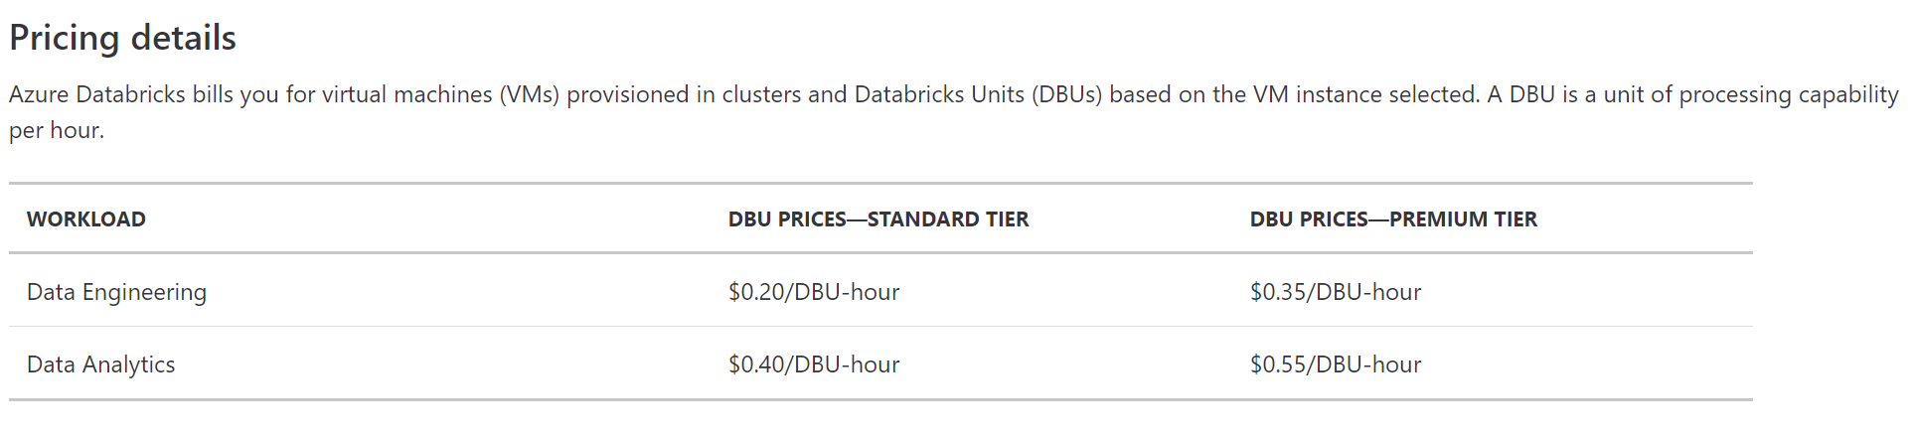
Pricing
← Automated workloads
← Interactive workloads
APACHE SPARK
DATABRICKS INTERACTIVE CLUSTERS Persistent clusters for analytics Auto-scaling Multi-user sharing and collaboration per cluster
DATABRICKS WORKSPACE SQL Python R and Scala notebooks One-click visualization Interactive dashboards Collaboration Revision history GitHub integration
DATABRICKS DELTA Indexing, Statistics and Caching Support Unified Batch and Stream Processing Transactional Guarantees
Role-based access control for notebooks, clusters, jobs, and tables
JDBC/ODBC Endpoint Authentication
Audit logs (coming soon)
Databricks DeltaIndexing, Statistics and Caching Support Unified Batch and Stream Processing Transactional Guarantees

Slide 16
Use Cases

Slide 17
Modern Big Data Warehouse
Ingest
Store
Prep & Train
Model & Serve
Intelligence
Logs, files and media (unstructured)
Data factory
Azure storage
Azure Databricks
(Spark)
Business / custom apps
(Structured)
Polybase
Data factory
Azure SQL Data Warehouse
Analytical dashboards

Slide 18
Advanced Analytics on Big Data
Ingest
Store
Prep & Train
Model & Serve
Intelligence
Logs, files and media (unstructured)
Data factory
Azure storage
Azure Databricks
(Spark Mllib, SparkR, SparklyR)
Azure Cosmos DB
Web & mobile apps
Business / custom apps
(Structured)
Polybase
Data factory
Azure SQL Data Warehouse
Analytical dashboards

Slide 19
Real-time Analytics on Big Data
Ingest
Store
Prep & Train
Model & Serve
Intelligence
Unstructured data
Azure HDInsight (Kafka)
Azure Databricks
(Spark)
Polybase
Azure storage
Azure SQL Data Warehouse
Analytical dashboards

Slide 20
Demo

Slide 21

How to get started
Try a Quickstart or Tutorial at: https://docs.microsoft.com/en-us/azure/azure-databricks/ https://github.com/MicrosoftLearning/databricks-intro
https://github.com/Azure/MachineLearningNotebooks/tree/master/how-to-use-azureml/azure-databricks
Engage Microsoft experts for a workshop to help identify high impact scenarios
Learn more about Azure Databricks www.azure.com/databricks
Notes:
Databricks, founded by the team that created Apache Spark – unified analytics platform that accelerates innovation by unifying data science, engineering & business.
75% of the code committed to Apache Spark comes from Databricks
Unified Runtime
Create clusters in seconds, dynamically scale them up and down.
They’ve made enhancements to Spark engine to make it 10x faster than open source Spark
Serverless- Auto-configured multi-user cluster, Reliable sharing with fault isolation
Unified Collaboration
Overall – a simple & collaborative environment that enables your entire team to use Spark & interact with your data simultaneously
DE – Improve ETL performance, zero management clusters. Execute production code from within notebooks
DS - For data scientists, easy data exploration in notebooks
Business SME – interactive dashboards empower teams to create dynamic reports
Enterprise Security
Encryption
Fine grained Role-based access control (files, clusters, code, application, dashboard)
Compliance
Rest APIs
DE – DBIO, SPARK, API’s , JOBS
DS – Spark and Serverless, Interactive Data Science
Data Products - Everything
Creators of Spark
Training People
Number of Customers
Ingest
Workflow
Schedule / Run / Monitor
Execute
Troubleshoot
Debug
Production Jobs
---------
Ingest, ETL, Scheduling, Monitoring

Slide 22
Q & A

Slide 23
Appendix

Slide 24
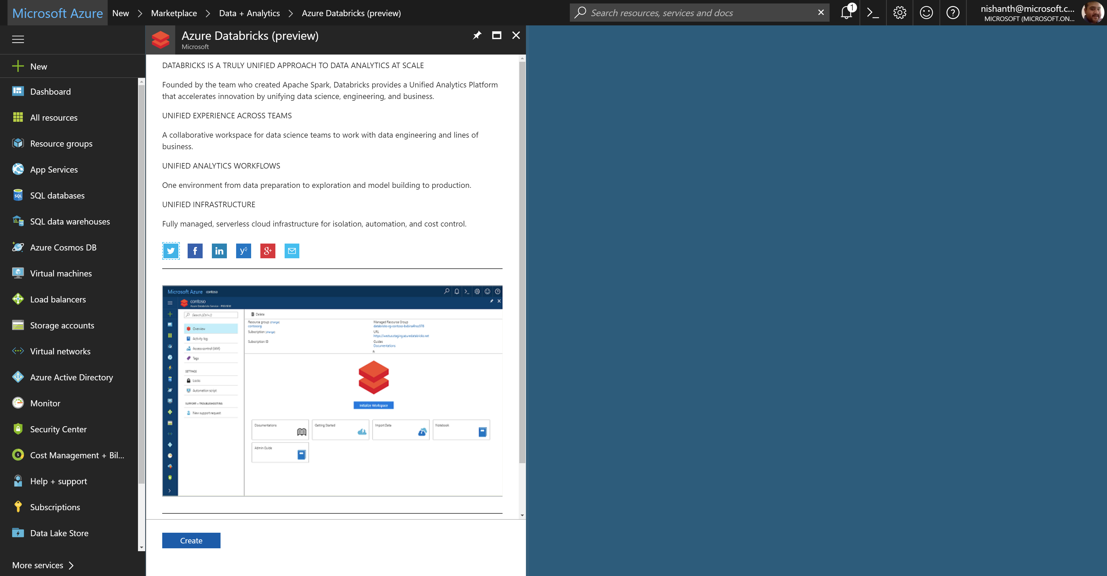
Azure Databricks – service home page

Slide 25
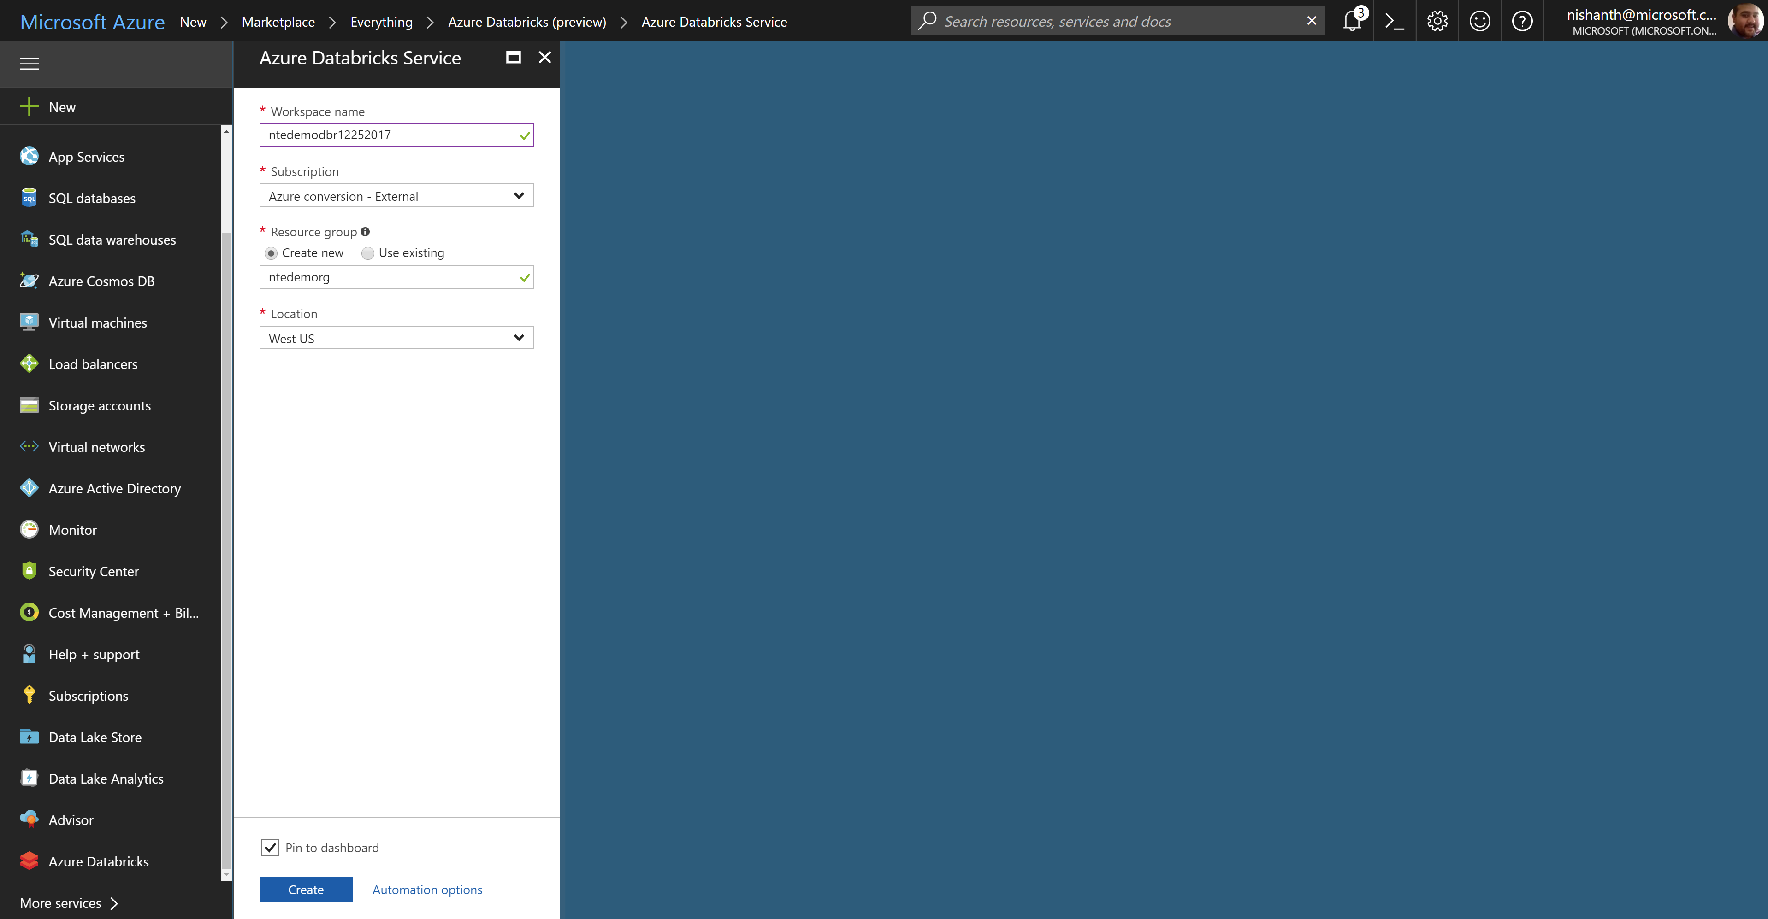
Azure Databricks – creating a workspace

Slide 26
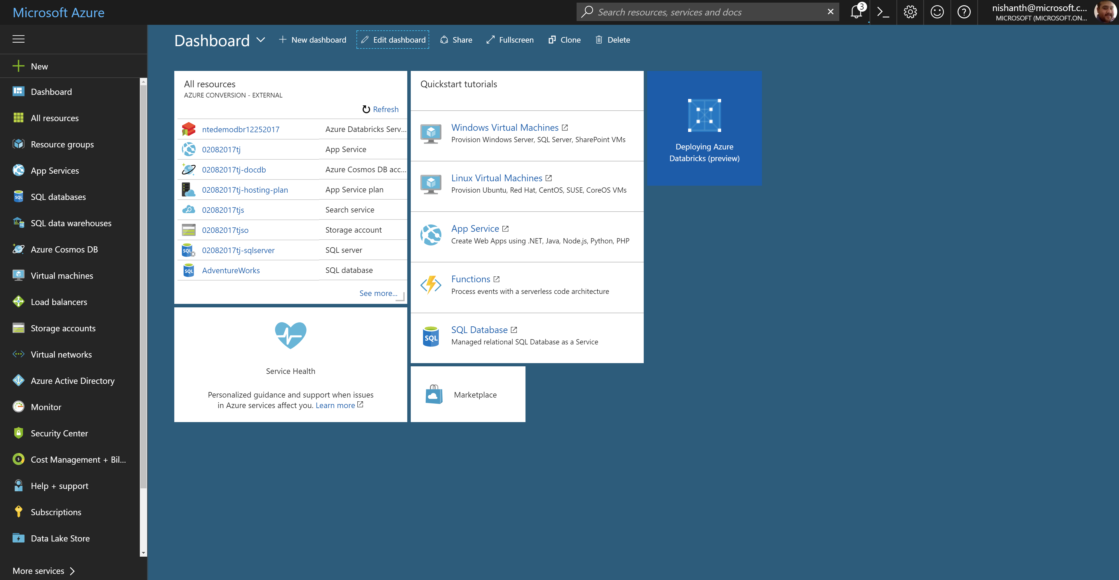
Azure Databricks – workspace deployment

Slide 27
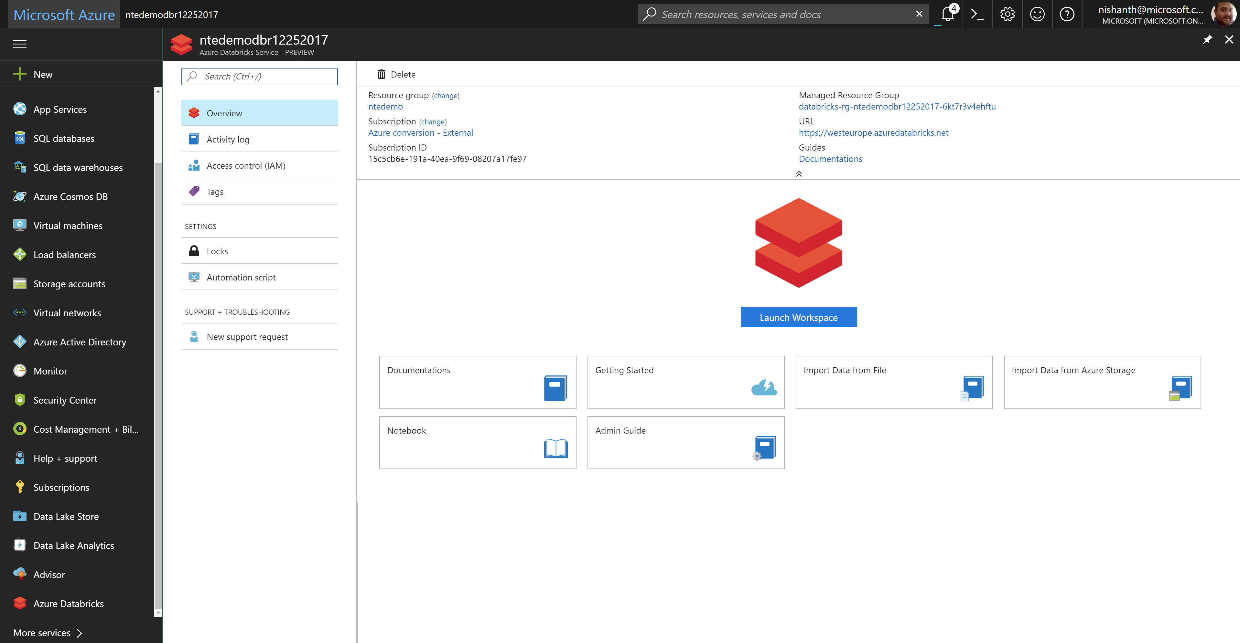
Azure Databricks – launching the workspace

Slide 28
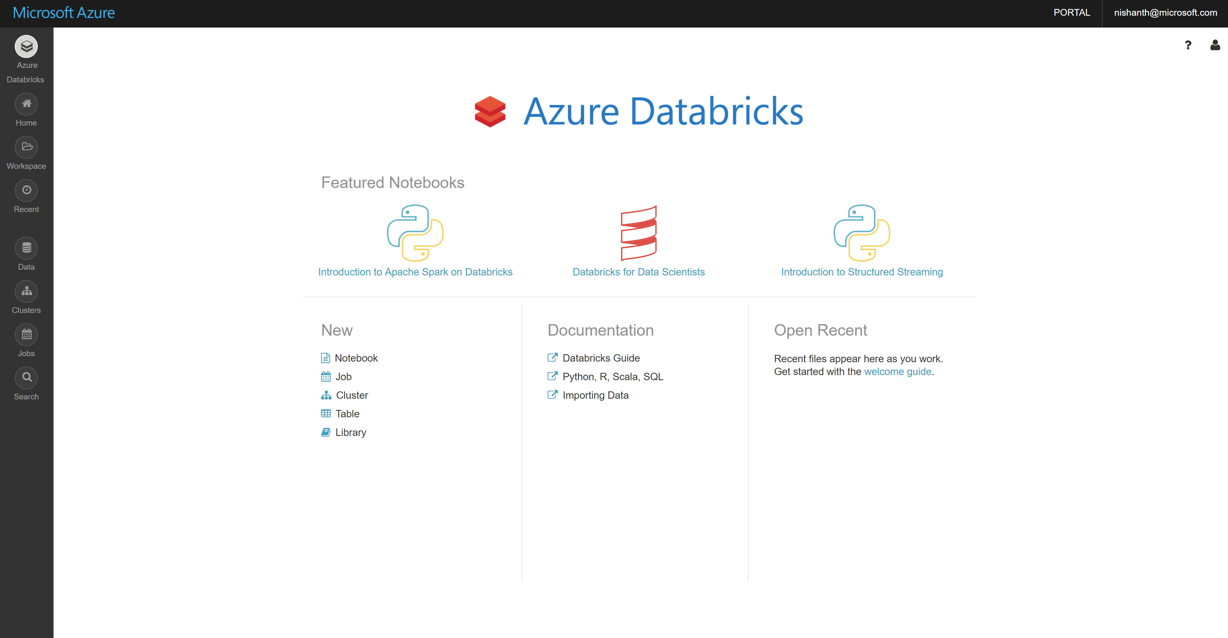
Azure Databricks – workspace home page

